Slide 1
Members and casual customers bike usage comparison
By Ashish P Kale
Updated : 30/04/2022

Slide 2
Sections
Differences in terms of demand
Differences in terms ride duration
Conclusion

Slide 3
Differences in terms of demand

Slide 4
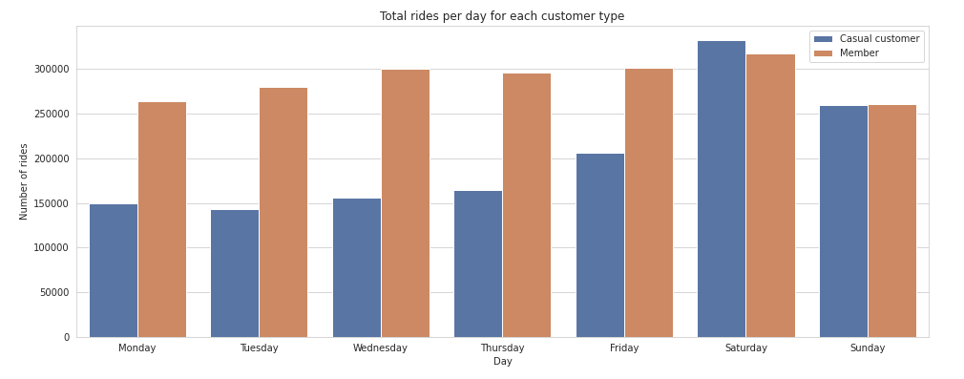
Day to day demand for bikes
Maximum casual rides demand on weekends.
Members demand is stable.
Notes:
Although, Members rides count is minimal on weekends, their demand on rides is fairly stable and it remains between 250k and slightly surpasses 300k on Saturday compared to casual customers demand which goes from less than 150k in workdays to more than 300k on Saturdays.

Slide 5
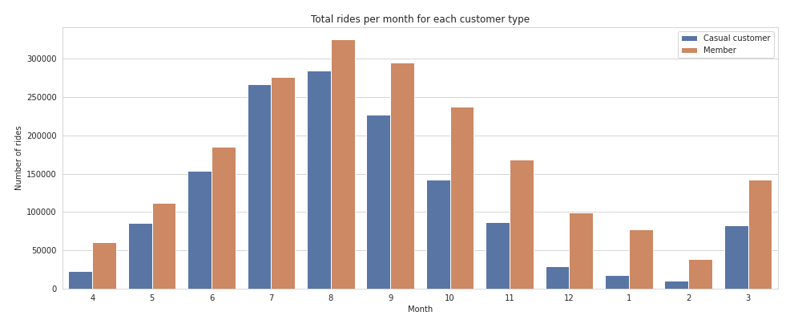
Monthly demand for rides
Customers prefer riding in summer.
Notes:
The demand on bike sharing service changes significantly around the year, this is probably because it snows in winter in Chicago.

Slide 6
Differences in terms of ride duration

Slide 7
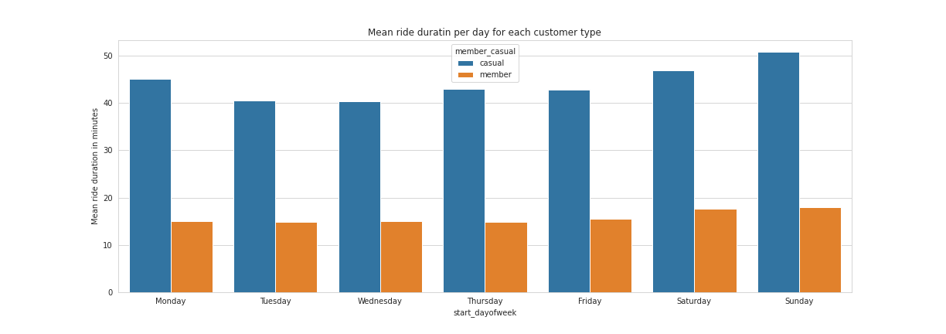
Average daily ride duration

Slide 8
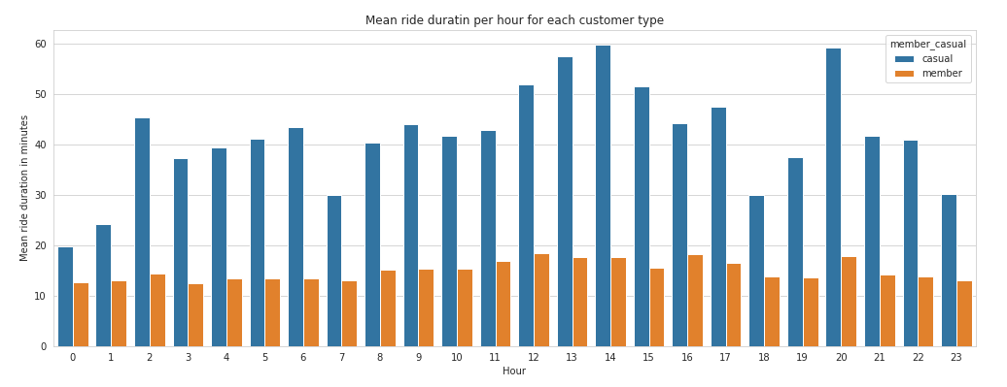
Average hourly ride duration
Average member ride
16 min
Average casual ride
45 min
Notes:
The average duration of a casual rides is 3 times that of a member's ride.
Members ride durations are short and show less dispersion

Slide 9
Conclusions

Slide 10
Casual customers ride for longer periods of time compared to members
Consider giving longer ride durations for members
Casual customers demand more bikes on weekend
Consider adding a weekend only subscription
Member rides are short, consistent and minimal in weekends

